Slide 1


Data Structure
Course Code : ENCS205
Dr Swati Gupta
Associate Professor, School of Engineering & Technology
K.R. Mangalam University
Unit 4 :Trees and Graphs
Notes:
New Courses replaced with New Programmes

Slide 2

TRAVERSAL OF TREES
Session 47
Basic concept of Tree Traversal Techniques
Tree Traversal Technique – Pre,In,Post order Techniques
Algorithm of Pre,In,Post Order Techniques
Test Your Knowledge Session
Notes:
New Courses replaced with New Programmes

Slide 3
RECAP
Tree is a collection of nodes that are connected by edges and has a hierarchical relationship between the nodes
A tree node includes the following parts:-
Data
Pointer to the left child
Pointer to the right child
Notes:
New Courses replaced with New Programmes

Slide 4
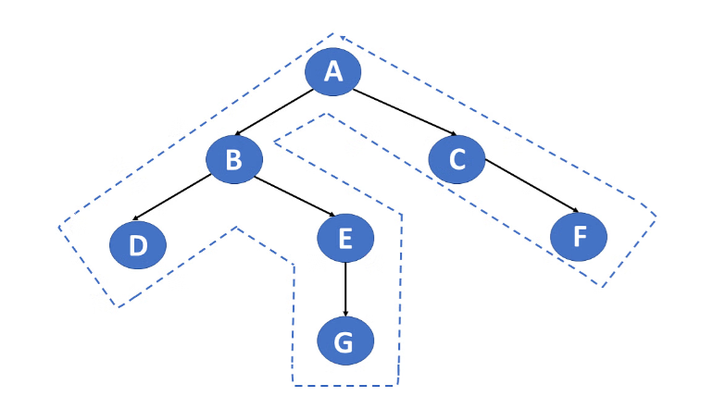
Tree Traversal
Tree Traversal: Traversal is the process of going through all nodes in the tree and printing the values.
There are three types of traversals
1. Preorder traversal
2. Inorder traversal
3. Postorder traversal
Source : https://www.simplilearn.com/tutorials/data-structure-tutorial/tree-traversal-in-data-structure.
Notes:
New Courses replaced with New Programmes

Slide 5
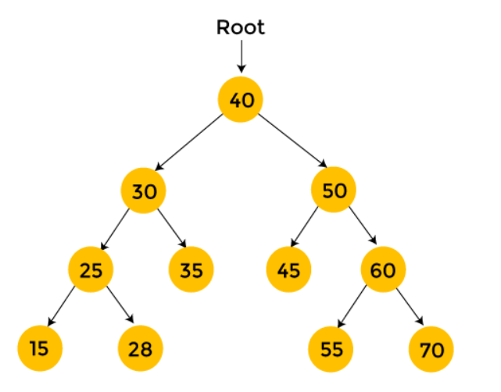
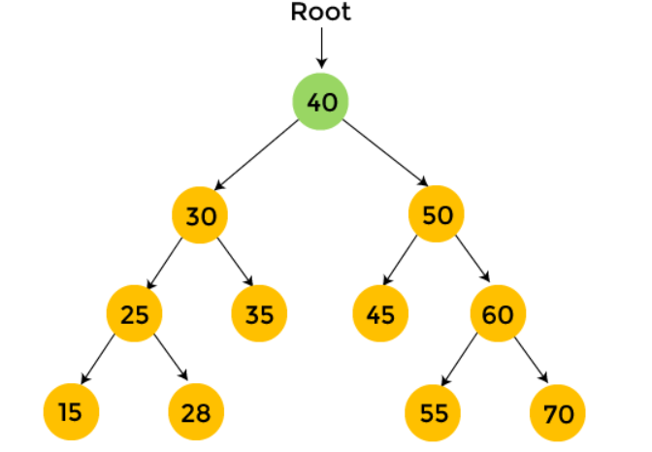
Tree Traversal :Preorder
Preorder traversal visits the node in the order: Root -> Left -> Right
Consider the following Tree for Preorder traversal
Step 1: Start with the root node 40. First, print 40 and then recursively traverse the left subtree.
Notes:
New Courses replaced with New Programmes

Slide 6
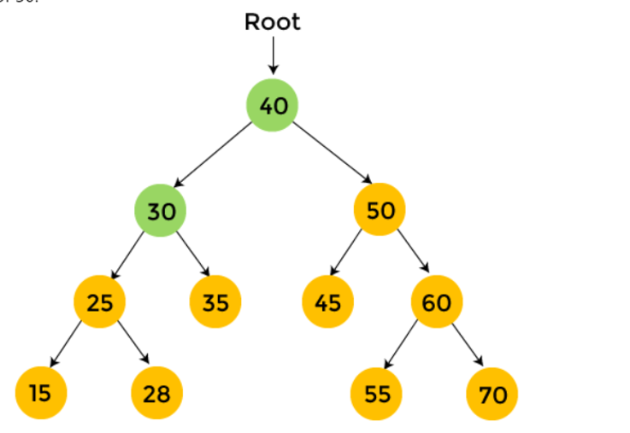
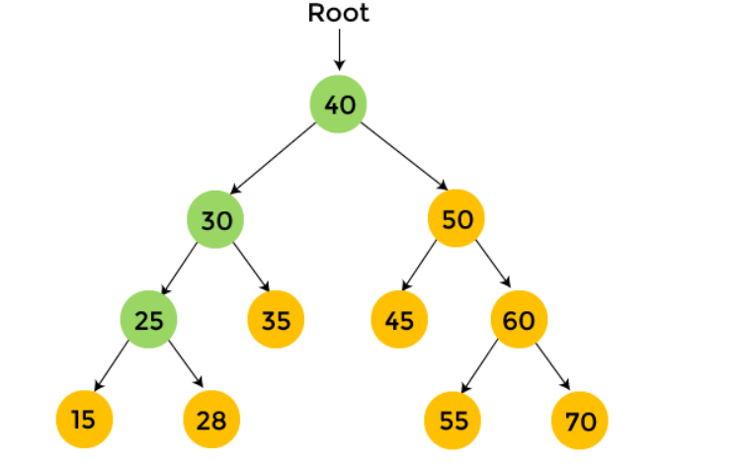
Tree Traversal :Preorder
Step 2 : Now, move to the left subtree. For left subtree, the root node is 30. Print 30, and move towards the left subtree of 30.
Step 3 :In left subtree of 30, there is an element 25, so print 25, and traverse the left subtree of 25.
Notes:
New Courses replaced with New Programmes

Slide 7
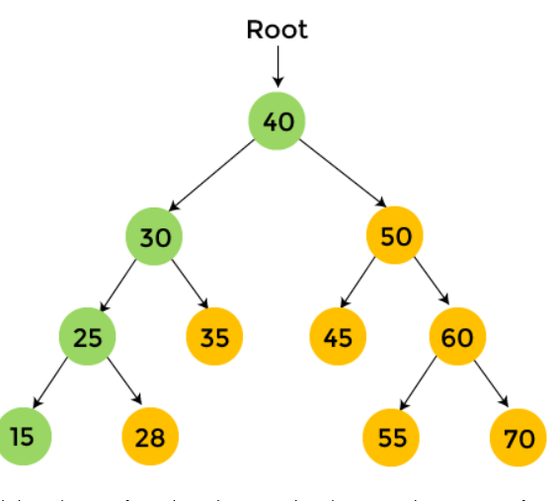
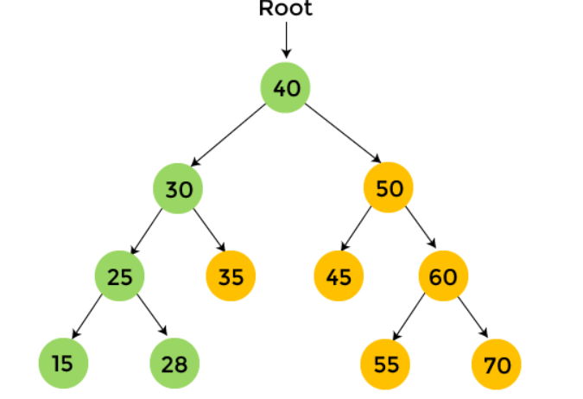
Tree Traversal :Preorder
Step 4 : In left subtree of 25, there is an element 15, and 15 has no subtree. So, print 15, and
move to the right subtree of 25.
Step 5 : In right subtree of 25, there is 28, and 28 has no subtree. So, print 28, and move to the right subtree of 30.
Notes:
New Courses replaced with New Programmes

Slide 8
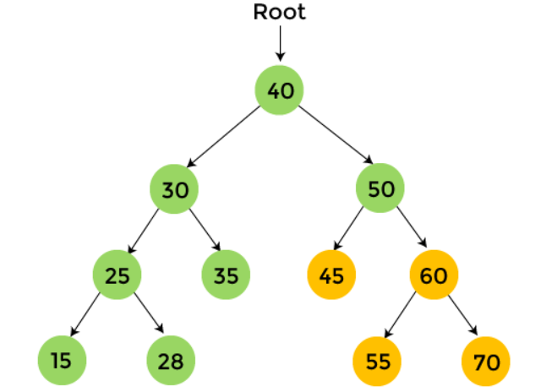
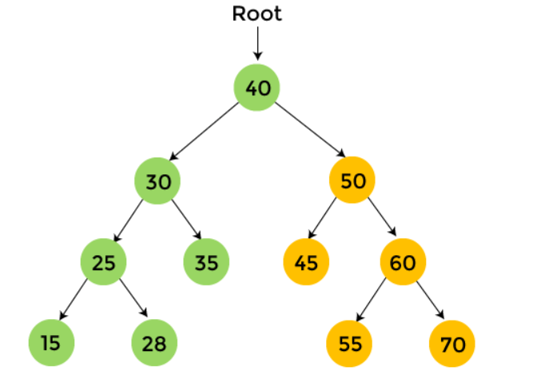
Tree Traversal :Preorder
Step 6 : In right subtree of 30, there is 35 that
has no subtree. So print 35, and traverse the right subtree of 40.
Step 7 : In the right subtree of 40, there is 50. Print 50, and traverse the left subtree of 50.
Notes:
New Courses replaced with New Programmes

Slide 9
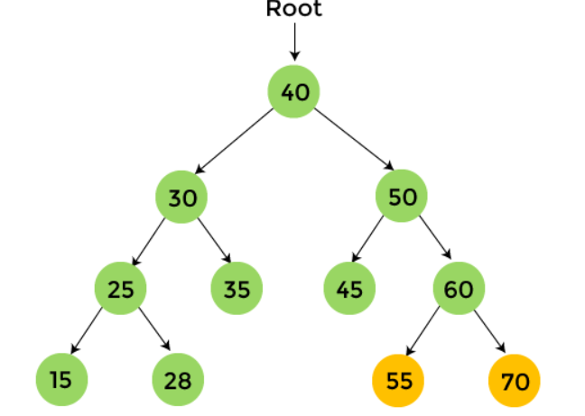
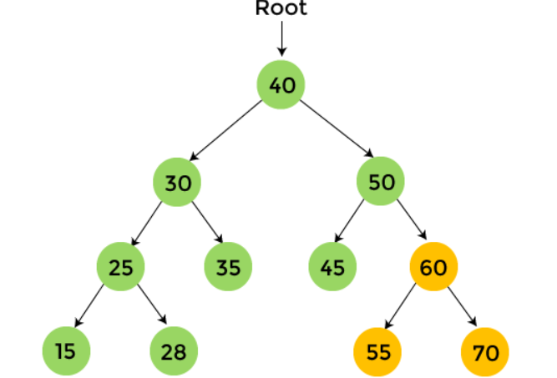
Tree Traversal :Preorder
Step 8 : In the left subtree of 50, there is 45 that do not have any child. So, print 45, and traverse the right subtree of 50.
Step 9 : In right subtree of 50, there is 60. Print 60 and traverse the left subtree of 60.
Notes:
New Courses replaced with New Programmes

Slide 10
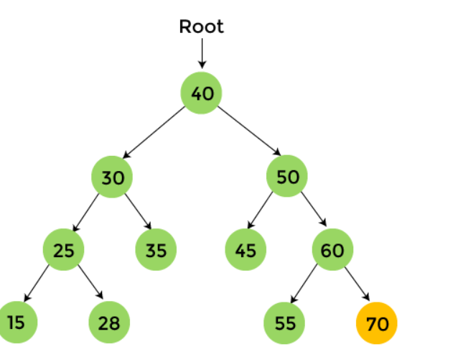
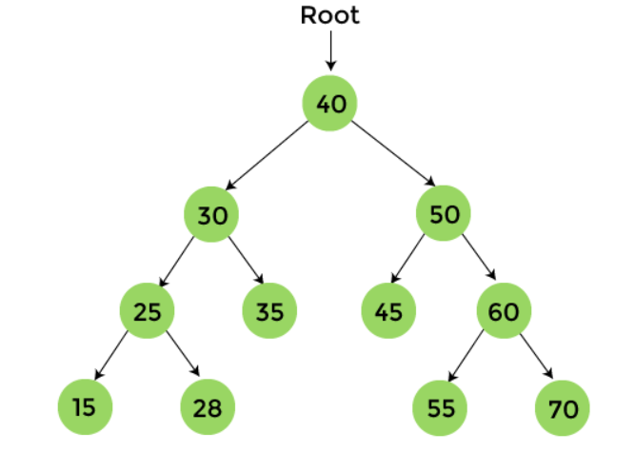
Tree Traversal :Preorder
Step 10 : In the left subtree of 60, there is 55
that does not have any child. So, print 55 and move to the right subtree of 60.
Step 11 : In the right subtree of 60, there is 70 that do not have any child. So, print 70 and stop the process.
Notes:
New Courses replaced with New Programmes

Slide 11
Tree Traversal :Preorder
After the completion of preorder traversal, the final output is -
40, 30, 25, 15, 28, 35, 50, 45, 60, 55, 70
Notes:
New Courses replaced with New Programmes

Slide 12
Algorithm : Pre Order Traversal
Preorder(tree)
Visit the root.
Traverse the left subtree, i.e., call Preorder(left->subtree)
Traverse the right subtree, i.e., call Preorder(right->subtree)
Notes:
New Courses replaced with New Programmes

Slide 13
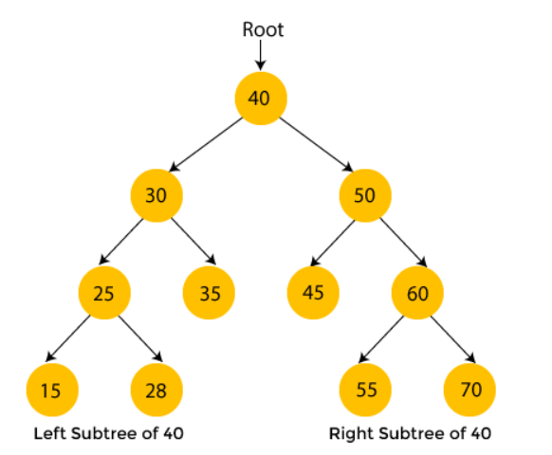
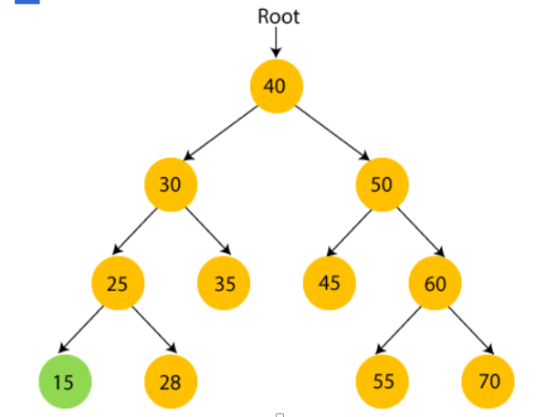
Tree Traversal :Inorder
Inorder traversal visits the node in the order: Left -> Root -> Right
Consider the following Tree for Inorder traversal
Step 1: 40 is the root node. We move to the left subtree of 40, that is 30,then 25 and we again move to the left subtree of 25 that is 15. so print 15 and move towards its parent node, 25.
Notes:
New Courses replaced with New Programmes

Slide 14
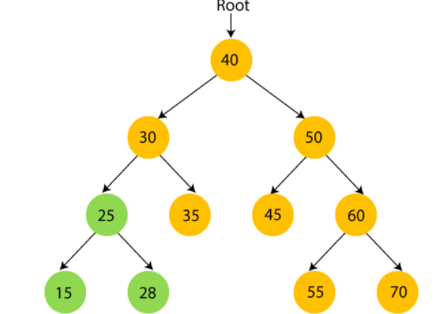
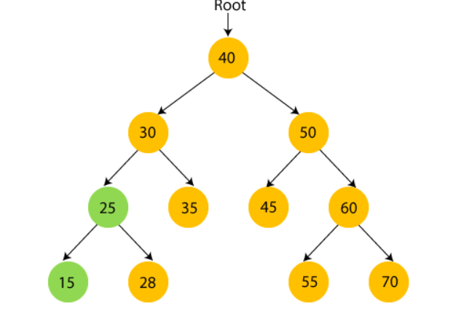
Tree Traversal :Preorder
Step 2 : Now, print 25 and move to the right subtree of 25.
Step 3 :Now, print 28 and move to the root node of 25 that is 30.
Notes:
New Courses replaced with New Programmes

Slide 15
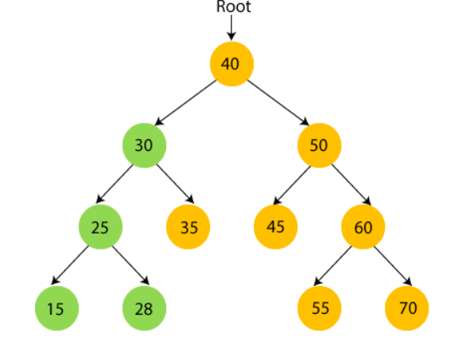
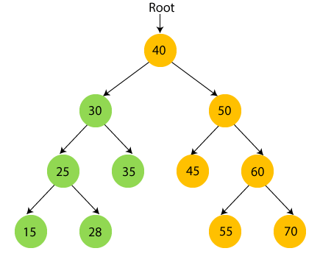
Tree Traversal :Preorder
Step 4 : So, left subtree of 30 is visited. Now,
print 30 and move to the right child of 30.
Step 5 : Now, print 35 and move to the root node of 30.
Notes:
New Courses replaced with New Programmes

Slide 16
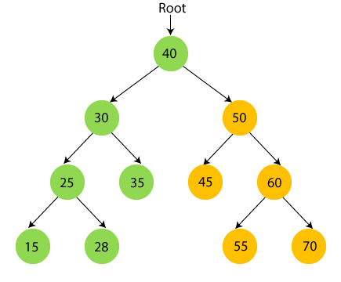
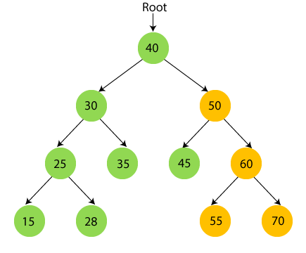
Tree Traversal :Preorder
Step 6 : Now, print root node 40 and move to its right subtree.
Step 7 : Now recursively traverse the right subtree of 40 that is 50. 50 have subtree so first traverse the left subtree of 50 that is 45, so print 45 and move to its root node.
Notes:
New Courses replaced with New Programmes

Slide 17
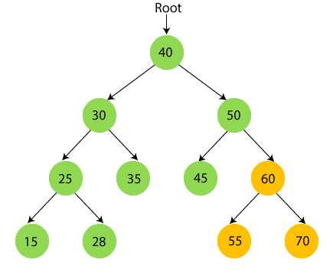
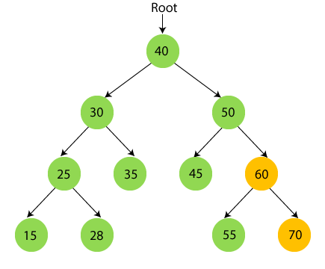
Tree Traversal :Preorder
Step 8 : Now print 50 and move to the right subtree of 50 that is 60.
Step 9 : Traverse the right subtree of 50 that is 60. 60 have subtree so first traverse the left subtree of 60 that is 55. so print 55 and move to its root node.
Notes:
New Courses replaced with New Programmes

Slide 18
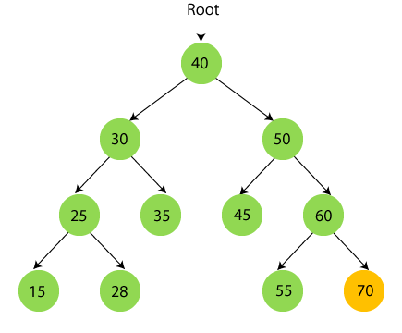
Tree Traversal :Preorder
Step 10 : Now print 60 and move to the right subtree of 60 that is 70.
Step 11 : print 70 and stop the process.
Notes:
New Courses replaced with New Programmes

Slide 19
Tree Traversal :Inorder
After the completion of inorder traversal, the final output is -
{15, 25, 28, 30, 35, 40, 45, 50, 55, 60, 70}
Notes:
New Courses replaced with New Programmes

Slide 20
Algorithm : Pre Order Traversal
Inorder(tree)
Traverse the left subtree, i.e., call Inorder(left->subtree)
Visit the root.
Traverse the right subtree, i.e., call Inorder(right->subtree)
Notes:
New Courses replaced with New Programmes

Slide 21
Implementing Traversal In Binary Tree
// Preorder traversal
// Postorder traversal.
void preorderTraversal(struct Node* node)
{
if (node == NULL)
return;
cout << node->data << "->";
preorderTraversal(node->left);
preorderTraversal(node->right);
}
void postorderTraversal(struct Node* node) {
if (node == NULL)
return;
postorderTraversal(node->left);
postorderTraversal(node->right);
cout << node->data << "->";
}

Slide 22
Implementing Traversal In Binary Tree
// Inorder traversal
Main Function
void inorderTraversal(struct Node* node) {
if (node == NULL)
return;
inorderTraversal(node->left);
cout << node->data << "->";
inorderTraversal(node->right);
}
int main() {
struct Node* root = new Node(1);
root->left = new Node(12);
root->right = new Node(9);
root->left->left = new Node(5);
root->left->right = new Node(6);
cout << "Inorder traversal ";
inorderTraversal(root);
cout << "\nPreorder traversal ";
preorderTraversal(root);
cout << "\nPostorder traversal ";
postorderTraversal(root);

Slide 23
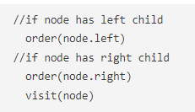
Test Your Knowledge
Q1 For the tree below, write the pre-order traversal.
From the following code identify the which traversal of a binary tree is this __________
(A) Inorder traversal (B) preorder traversal (C) postorder traversal (D) Euler tour traversal
Answer (C)
Notes:
New Courses replaced with New Programmes

Slide 24
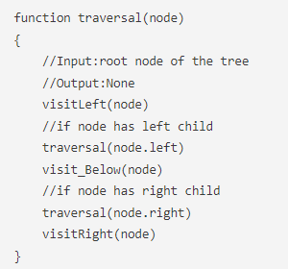
Test Your Knowledge
Q2 From the following code identify the which traversal of a binary tree is this __________
(A) Inorder traversal (B) preorder traversal (C) postorder traversal (D) Euler tour traversal
Answer (B)
Notes:
New Courses replaced with New Programmes

Slide 25
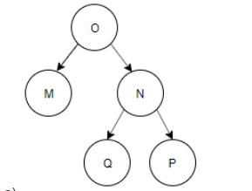
Test Your Knowledge
Q4 Construct a binary tree by using postorder and inorder sequences given below. Inorder: N, M, P, O, Q Postorder: N, P, Q, O, M
(A) Inorder traversal (B) preorder traversal (C) postorder traversal (D) Euler tour traversal
Answer (B)
Notes:
New Courses replaced with New Programmes

Slide 26
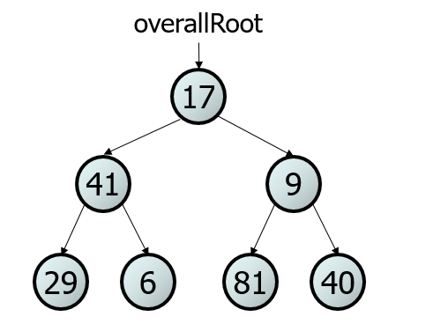
Tree Traversal :Exercise
pre-order: 17 41 29 6 9 81 40
in-order: 29 41 6 17 81 9 40
post-order:29 6 41 81 40 9 17
Notes:
New Courses replaced with New Programmes

Slide 27
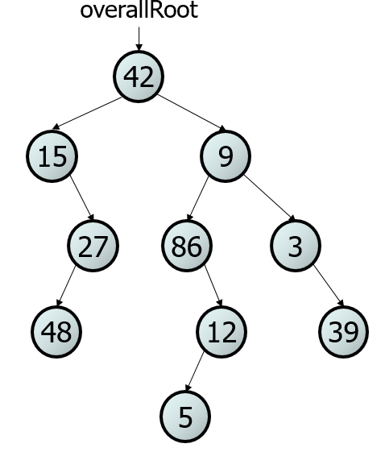
Tree Traversal : Exercise
Give pre-, in-, and post-order traversals for the following tree:
Notes:
New Courses replaced with New Programmes

Slide 28
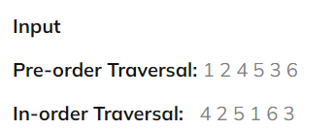

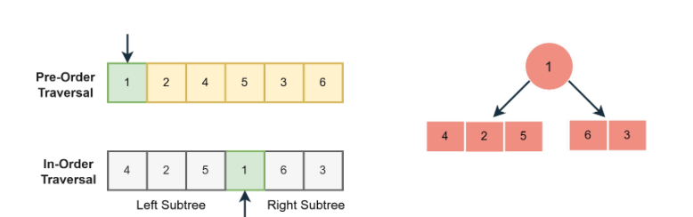
Constructing a Binary Tree
Step 1: First, we will create the tree's root, and initially, the preIndex would be at the first element of the pre-order array.
Notes:
New Courses replaced with New Programmes

Slide 29
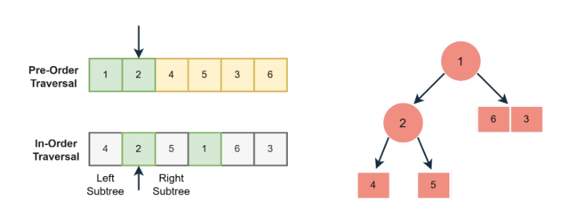
Constructing a Binary Tree
Step 2: In the second step, we will first create the left subtree, and our preIndex will be increment, which will now point to 2. Therefore, 2 will be the root of the left subtree.
Notes:
New Courses replaced with New Programmes

Slide 30
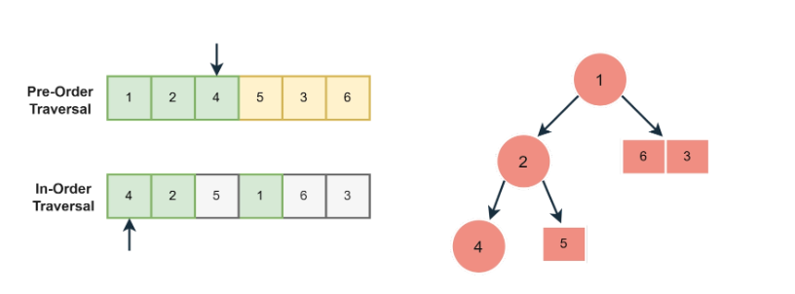
Constructing a Binary Tree
Step 3: In the third step, the left child of the left subtree of root node 2 will be created; here, it will be 4. The preIndex will now point to 4.
Notes:
New Courses replaced with New Programmes

Slide 31
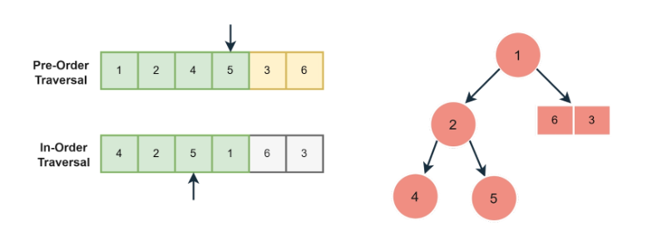
Constructing a Binary Tree
Step-4 : In this step, we will create the right child of the left subtree, and preIndex will be incremented to point to 5.
Notes:
New Courses replaced with New Programmes

Slide 32
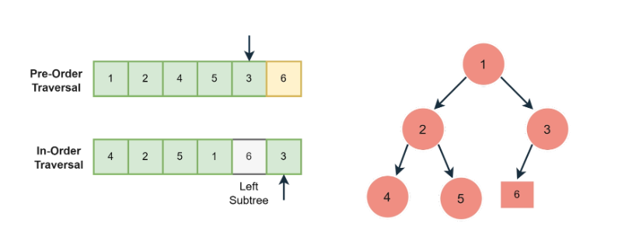
Constructing a Binary Tree
Step-5 : Now, again, we will repeat the above steps. Since we have created the left subtree, we will now create the right subtree. preIndex will be incremented, and now it will point to 3 so a new node with value 3 will be created.
Notes:
New Courses replaced with New Programmes

Slide 33
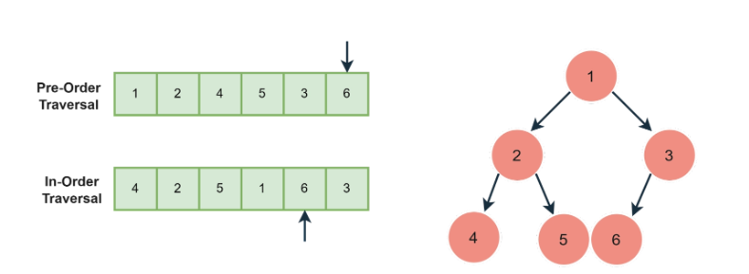
Constructing a Binary Tree
Step-6 : In the last, we will create the left subtree of node 3, which only contains one node, i.e., 6; preindex will point to the last element of the Pre-order array.
Notes:
New Courses replaced with New Programmes

Slide 34
Exercise : Tree Traversal
Given the Preorder and Post order Traversal of a binary tree, construct the unique binary tree represented by them.
Given traversals: Preorder: 50, 25, 12, 37, 30, 40, 75, 62, 60, 70, 87 Postorder: 12, 30, 40, 37, 25, 60, 70, 62, 87, 75, 50
Notes:
New Courses replaced with New Programmes

Slide 35
Test Your Knowledge
Q1 Postorder traversal of a given binary search tree, T produces the following sequence of keys 10, 9, 23, 22, 27, 25, 15, 50, 95, 60, 40, 29 Which one of the following sequences of keys can be the result of an in-order traversal of the tree T?
A) 9, 10, 15, 22, 23, 25, 27, 29, 40, 50, 60, 95 (B) 9, 10, 15, 22, 40, 50, 60, 95, 23, 25, 27, 29 (C) 29, 15, 9, 10, 25, 22, 23, 27, 40, 60, 50, 95 (D) 95, 50, 60, 40, 27, 23, 22, 25, 10, 9, 15, 29
Answer (A)
Notes:
New Courses replaced with New Programmes

Slide 36
Test Your Knowledge
Q2 Postorder traversal of a given binary search tree, T produces the following sequence of keys 10, 9, 23, 22, 27, 25, 15, 50, 95, 60, 40, 29 Which one of the following sequences of keys can be the result of an in-order traversal of the tree T?
(A) 9, 10, 15, 22, 23, 25, 27, 29, 40, 50, 60, 95 (B) 9, 10, 15, 22, 40, 50, 60, 95, 23, 25, 27, 29 (C) 29, 15, 9, 10, 25, 22, 23, 27, 40, 60, 50, 95 (D) 95, 50, 60, 40, 27, 23, 22, 25, 10, 9, 15, 29
Answer (A)
Q3 Consider a node X in a Binary Tree. Given that X has two children, let Y be Inorder successor of X. Which of the following is true about Y? (A) Y has no right child (B) Y has no left child (C) Y has both children (D) None of the above
Answer: (B)
Notes:
New Courses replaced with New Programmes

Slide 37
REVIEW
Traversal is the process of going through all nodes in the tree and printing the values.
Tree Data Structure can be traversed in following ways:
Inorder Traversal
Preorder Traversal
Postorder Traversal
Notes:
New Courses replaced with New Programmes

Slide 38
References
https://www.youtube.com/watch?v=oSWTXtMglKE
https://www.upgrad.com/blog/5-types-of-binary-tree/
https://www.javatpoint.com/tree
https://www.geeksforgeeks.org/tree-data-structure/
https://www.sanfoundry.com/1000-data-structure-questions-answers/
https://www.tutorialspoint.com/data_structures_algorithms/array_data_structure.htm
https://www.tutorialspoint.com/data_structures_algorithms/tree_data_structure.htm
https://www.simplilearn.com/tutorials/data-structure-tutorial/trees-in-data-structure
https://www.scaler.com/topics/data-structures/tree-data-structure/
Notes:
New Courses replaced with New Programmes

Slide 39
THANK YOU

